Slide 1
Final Project
By jesus Velasquez

Slide 2
WHAT IS MY FINAL PROJECT?
My final project is a simple workout program with 4 different classes. The base class starts as Person with 2 children, Athletic, and Handicapped.
I use multiple inheritance to create a 4th class known as “Para-Olympic Athlete”
Each class has separate “stats” that determine how much stamina is a lost and gained after working out and resting.
We use runtime polymorphism to see how each different person with all their different added attributes are affected.

Slide 3
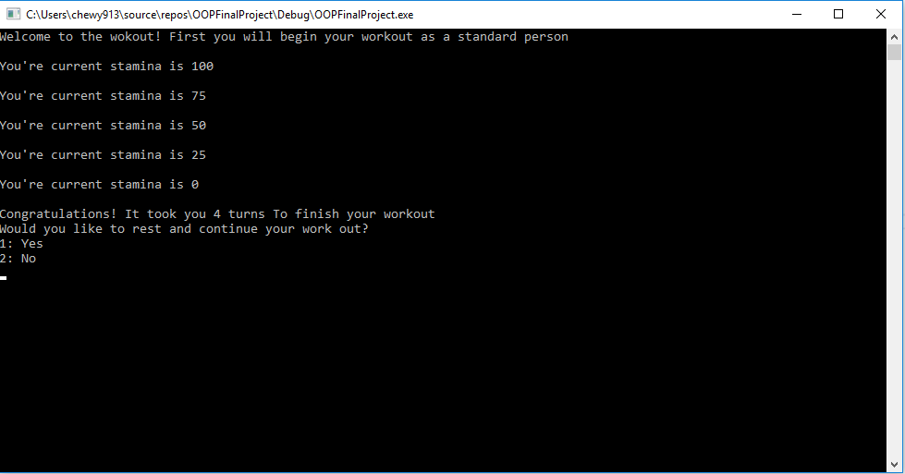
Standard Person(Base Class)
For the base class person there are no buffs or debuffs so they heave have a decrement of 25
If the user decides to rest they will gain stamina according to their stamina gain rate. And proceed to work out more to get a higher turn.
All members in class are only accessible via getters and setters

Slide 4
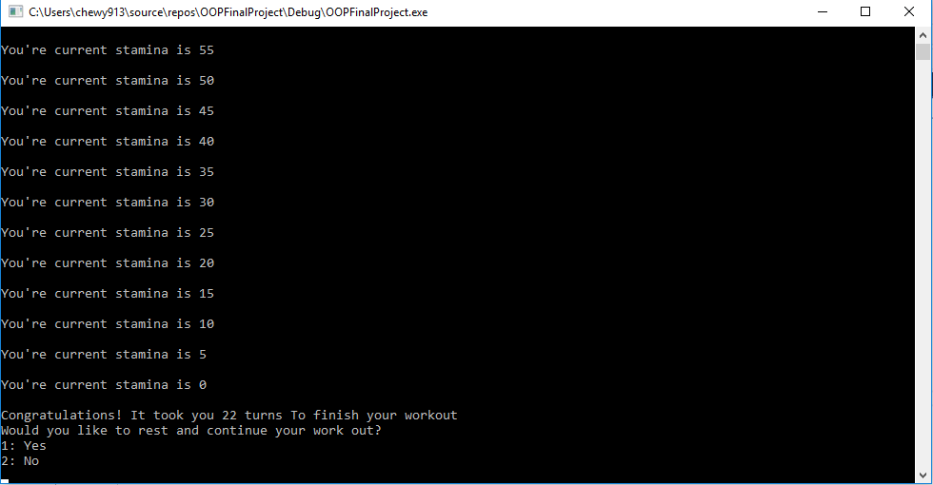
Athletic person(Child)
For the child class Athletic there are the same functions but with overrides to account for their member “enhanced stamina”
Virtual functions were used in creating of methods to avoid multiple constructor calls
As you can see, there was an increase in turns for an athletic person.

Slide 5
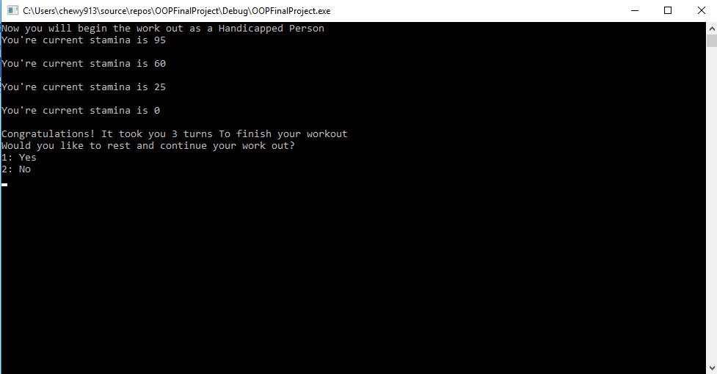
Handicapped Person(Child)
For the child class Handicapped there are the same functions but with overrides to account for a “decreased stamina”
Virtual functions were used in creating of methods to avoid multiple constructor calls just like the previous child
As you can see, there was an significant decrease in turns for a handicapped person vs athletic and standard

Slide 6
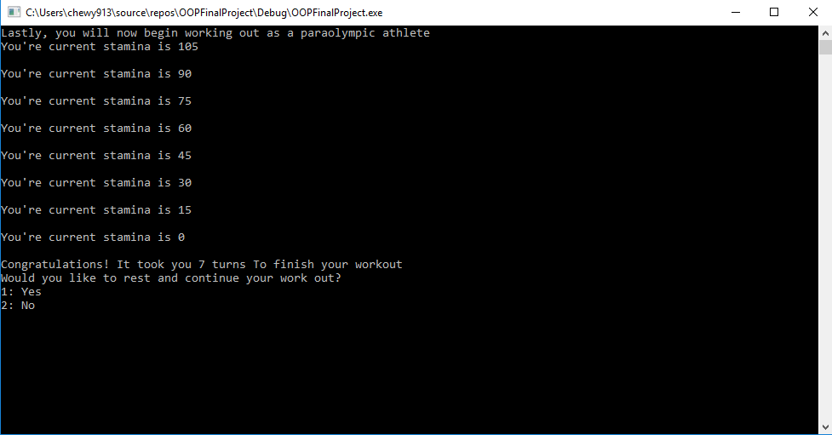
ParaOlympic(GrandChild)
ParaOlympic class inherits from both the handicapped person and the athletic person. They have no additional members as it inherited the debuffs from both parents.
This also shows in the amount of turns. A paraOlympic athlete is better than a handicapped person and a standard person but still at a disadvantage to a full on athlete.
Had overrides to adjust for both the decrement and increment of stamina ability

